Slide 1
PRODUCT LANDING PAGE
By
Gosala marisha(22MH1A4917)
Of
IInd IoT

Slide 2
TITLE
TITLE: Creating a product landing page for shoes
SUBTITLE: Using HTML,CSS and JavaScript
NAME: G.Marisha

Slide 3

What is web development?

Slide 4
Web development , also known as website development , refers to the tasks associated with creating , building and maintaining websites and web applications that run online on a browser.
In web development , it contains
Frontend development
Backend development
I chooses Frontend development to build this landing page by using HTML,CSS and Javascript

Slide 5
INTRODUCTION ABOUT LANDING PAGE
A product landing page is a standalone web page created specifically for a marketing or advertising campaign.
Its primary purpose is to drive visitors to take a specific action, such as making a purchase, signing up for a newsletter, or downloading a resource.
Unlike other web pages that may serve multiple purposes

Slide 6
PROJECT OVERVIEW
Objectives:
Create a visually appealing and functional landing page for a shoe product
Utilize HTML for structure,CSS for styling and javascript for interactivity

Slide 7
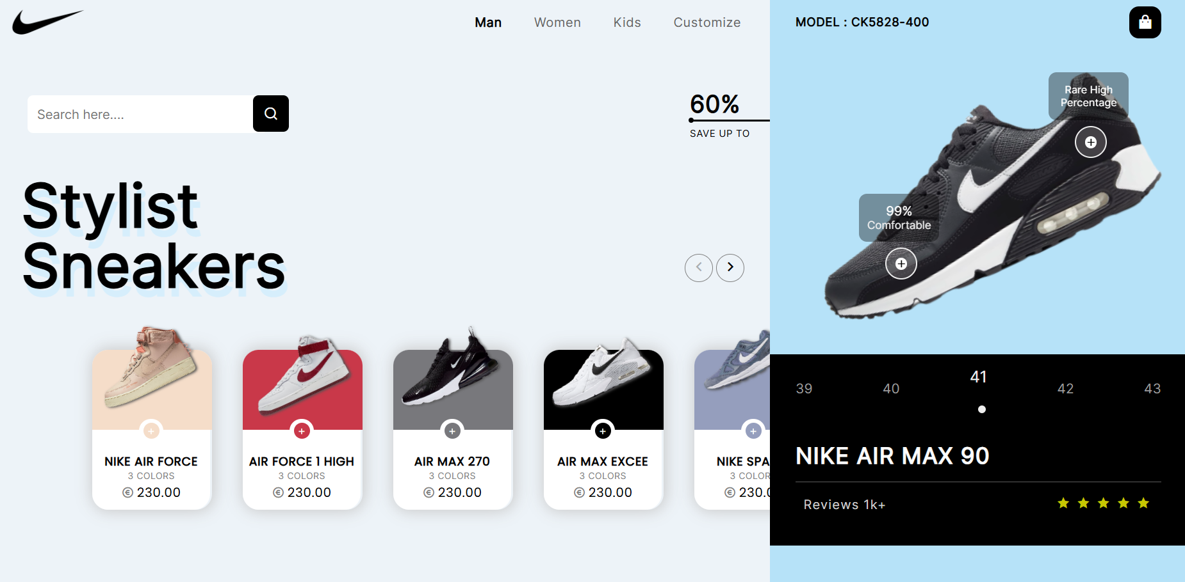
OVERVIEW OF MY LANDING PAGE

Slide 8
KEY FEATURES
Responsive Design:
Viewport Settings: Ensures the page adapts to different screen sizes and devices using the viewport meta tag.
CSS Media Queries: Uses CSS to provide a responsive layout that adjusts for mobile, tablet, and desktop views.

Slide 9
Clear Branding:
Logo Display: Prominently displays the brand logo
Consistent Color Scheme: Uses a cohesive color scheme that matches the brand’s identity.
Navigation:
Main Navigation Bar: Provides easy access to different product categories (man, women, kids, customize).
Search Functionality: Includes a search bar for users to find specific products quickly.
Secondary Navigation: Offers additional navigation options in the right container, including model numbers and a shopping cart button.
Product Showcase:
Product Images: Displays high-quality images of products, allowing users to see the products clearly (nike-air-force.png, nike-air-force-1-high.png, etc.).
Product Descriptions: Provides concise and informative descriptions, including product names, colors, and prices.
Add to Cart Button: Includes an easily accessible add-to-cart button for each product.

Slide 10
THANK YOU

